Slide 1
U-Boot – The Universal Bootloader
Booting from different sources

Slide 2
Booting process
SoC ROM Bootloader
Texas Instrument AM335x ROM Bootloader
1
First Stage Bootloader
SPL/MLO (Secondary Program Loader/Memory Loader)
2
Second Stage Bootloader
U-boot + uEnv.txt
3
Linux Kernel
Device Tree File
Linux Kernel zImage / uImage
am335x-boneblack.dtb
4
Root Filesystem
Init Process
Root Filesystem
5

Slide 3
SoC ROM Bootloader
Get’s executed first, also called Primary Program Loader
Similar to BIOS on PCs
Loads another bootloader (U-boot/SPL, for example)
Minimum booting capabilities
On BBB, it looks for MLO file in an specific location
MLO file is copied to Static RAM (because RAM is not initialized yet)
Cannot be written/updated (ROM Memory)
Programmed only once at factory/assembly level

Slide 4
SPL
U-boot’s Secondary Program Loader
Stripped down version of the full-blown U-boot binary
Regular bootloaders (like u-boot) are bigger than SRAM
SPL is loaded by ROM bootloader
SPL initializes regular RAM and loads regular bootloader

Slide 5
U-boot
Third Stage Bootloader
Main purpose: to boot the Linux Kernel
Linux kernel could be loaded from different mediums
Non-volatile flash Memory – eMMC, NAND, NOR, SD Card.
USB
Network – NFS, TFTP
Comes with a lot of different features such as an interactive shell
One can think of it as a “Really small kernel”

Slide 6
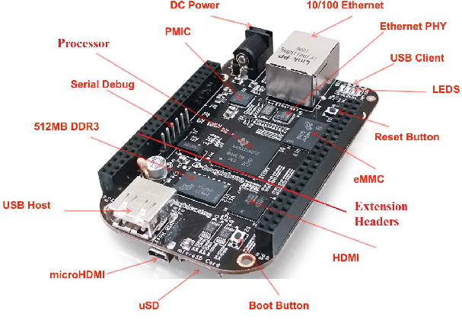
BBB - Features

Slide 7
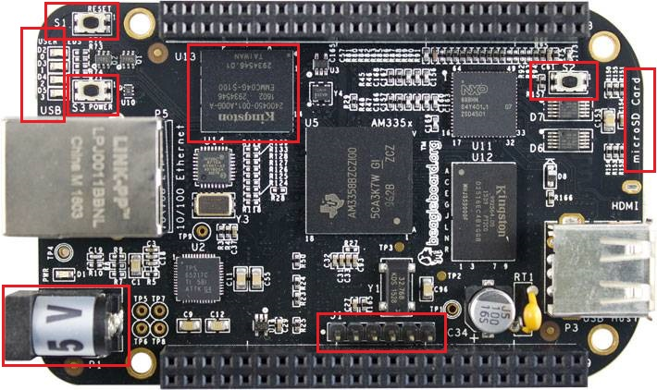
BBB - Features

Slide 8
BBB – Features
Power Button (S3)
Reset Button (S1)
Boot Button (S2)
Mini USB (Underneath User LEDs)
Do not user USB Host connector to power up unit
5V DC Power
Serial Debug Interface
eMMC
uSD Card Slot

Slide 9
BBB – Boot switch/button (S2)
Change boot sequence.
Push and hold while powering up the device
Default mode (not pressed)
MMC1 (onboard eMMC)
MMC0 (external uSD Card)
UART0
USB0
Boot sequence changed (pressed)
SPI0
MMC0 (external uSD Card)
UART0
USB0

Slide 10
BBB – Flashing images
It comes with a Debian distribution pre-installed
Update process to the latest SW version is very easy
SD card
Download latest software version: https://beagleboard.org/latest-images
Use https://www.balena.io/etcher/ to flash the OS image to the SD Card
Already flashed with official and recent Debian Distro image:
NO: With the BBB turned off, insert uSD Card, push and hold the BOOT button and turn it on
YES: With the BBB turned off, insert uSD Card and apply power
With the BBB turned off, push and hold the BOOT button and apply power
Wait for the flashing process to finish, it could take a while
SD Card can be used to test images without touching eMMC contents

Slide 11
BBB – Flashing images
Use “flasher” images when you want to flash to the eMMC
Use regular or “not-flasher” images when you only want to boot from uSD card and not flash.

Slide 12
BBB – SPL loading
AM335x capable of reading SPL/MLO from uSD card (or eMMC) in:
RAW mode
1 of the 4 consecutive locations in main memory area:
0x00000 (0KB) / 0x20000 (128KB) / 0x40000 (256KB) / 0x60000 (384KB)
FAT Filesystem mode
ROM Code will look for a specific booting file named MLO
FAT12/16 or FAT32 active primary partition

Slide 13
Lab – Cross compile u-boot
dpkg -L gcc-arm-linux-gnueabi
sudo apt-get install gcc-arm-linux-gnueabi
git clone https://github.com/u-boot/u-boot.git
mkdir u-boot_build
cd u-boot
export ARCH=arm
export CROSS_COMPILE=arm-linux-gnueabi-
make am335x_evm_defconfig O=../u-boot_build
make O=../u-boot_build

Slide 14
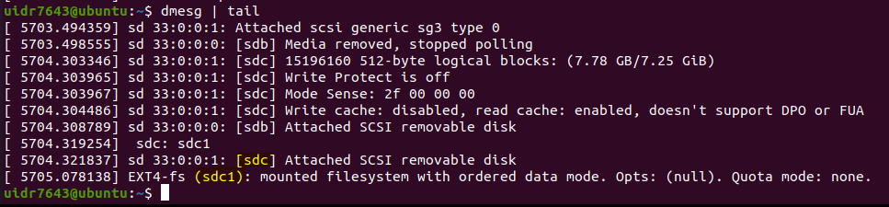
Lab – Prepare uSD Card contents
Find out correct block device name
Connect uSD Card to the USB SD Card Reader and connect it to Host
dmesg | tail

Slide 15
Lab – Boot custom u-boot from uSD Card
Copy both MLO and u-boot.img to SD using
RAW mode
sudo dd if=/dev/zero of=${DISK} bs=1M count=10
sudo dd if=u-boot_build/MLO of=${DISK} count=1 seek=1 bs=128k
sudo dd if=u-boot_build/u-boot.img of=${DISK} count=2 seek=1 bs=384k
FAT Filesystem mode
cp u-boot_build/MLO u-boot_build/u-boot.img /media/$USER/sdboot

